Slide 1
Laravel Framework
(45 hours)
Notes:
Title - The learning outcome
Subtitle - Duration

Slide 2
In this section, we will discuss:
Introduction to MVC Architecture.
What is framework and its Benefits
Laravel and its architecture.
Blade templating engine in laravel
Notes:
Mention the parent topics one by one. This particular learning outcome has 4 parent topics.

Slide 3
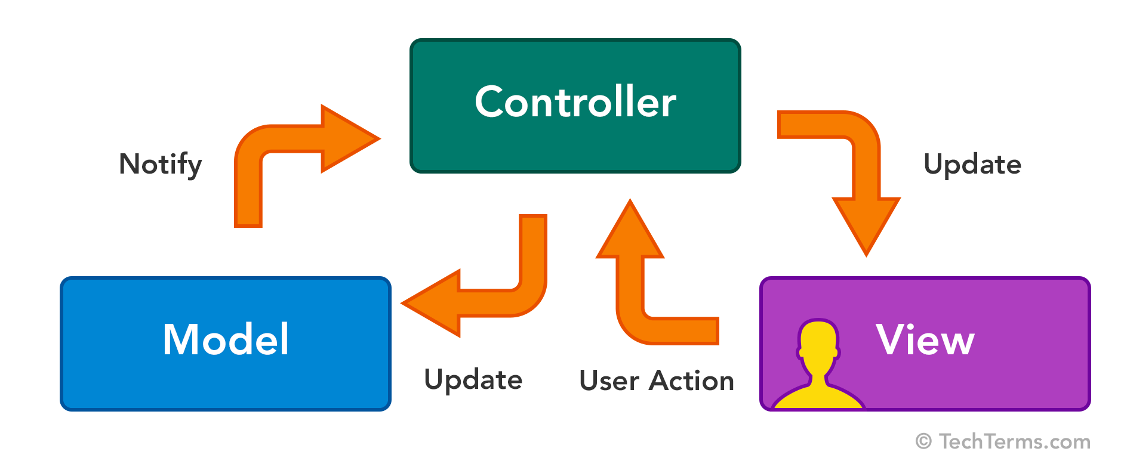
Introduction to MVC Architecture
What is MVC Framework
The Model-View-Controller (MVC) framework is an architectural pattern that separates an application into three main logical components Model, View, and Controller.
Nowadays, MVC architecture in web technology has become popular for designing web applications as well as mobile apps.
Image Source:https://techterms.com/img/lg/mvc_1321.png
Notes:
Left (White Color space):
Title - Parent Topic
Subtitle - Subtopic 1
Body Text - Description in bullets
Right (Grey Color Space):
Body Text - Relevant image (with source)/code snippet
Put reference links in Speaker Notes
Reference:
https://www.tutorialspoint.com/internet_technologies/internet_overview.htm/

Slide 4
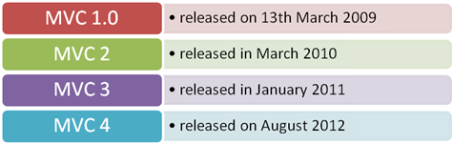
Introduction to MVC Architecture
History of MVC
MVC architecture was first discussed in 1979 by Trygve Reenskaug
MVC model was first introduced in 1987 in the Smalltalk programming language.
MVC was first time accepted as a general concept, in a 1988 article
In the recent time, MVC pattern is widely used in modern web applications
Image Source: https://www.codeproject.com/KB/aspnet/669195/image001.png
Notes:
This slide talks about the case if we have to divide a subtopic further.
Title Box - Parent Topic
Subtitle box - Sub Topic
Body Text - Subtopic divisions (Subtopics of subtopics)

Slide 5

Introduction to MVC Architecture
Features of MVC
Easy and frictionless testability. Highly testable, extensible and pluggable framework
To design a web application architecture using the MVC pattern, it offers full control over your HTML as well as your URLs
Leverage existing features provided by ASP.NET, JSP, Django, etc.
Supports for Test Driven Development (TDD)
Image Source: https://www.onlinesolutionsgroup.de/wp-content/uploads/Feature-Creep-1-750x390.jpg
Notes:
This slide talks about the case if we have to divide a subtopic further.
Title Box - Parent Topic
Subtitle box - Sub Topic
Body Text - Subtopic divisions (Subtopics of subtopics)

Slide 6
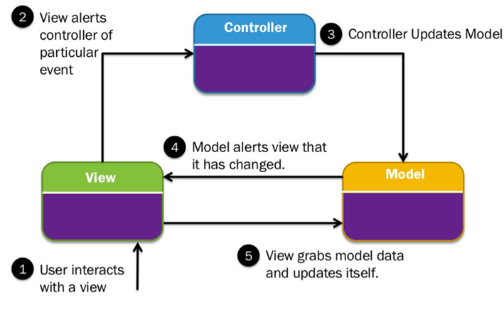
Introduction to MVC Architecture
MVC Architecture
MVC is an architectural pattern which means it rules the whole architecture of the applications.
Three important MVC components are:
Model
View
Controller
Image Source: https://www.chromeinfotech.net/blog/wp-content/uploads/2019/05/MVC-diagram-1.png
Notes:
This slide talks about the case if we have to divide a subtopic further.
Title Box - Parent Topic
Subtitle box - Sub Topic
Body Text - Subtopic divisions (Subtopics of subtopics)

Slide 7
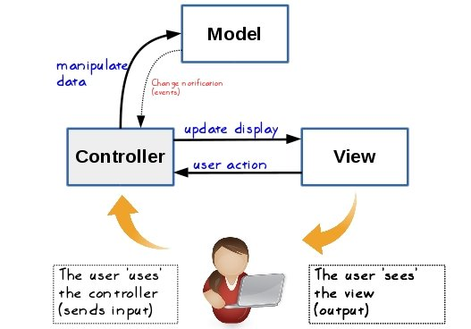
MVC Architecture
Model
This level is considered the lowest level when compared with the View and Controller.
It primarily represents the data to the user and defines the storage of all the application’s data objects.
Image Source: https://static.packt-cdn.com/products/9781785889196/graphics/B05034_10_01.jpg
Notes:
This slide talks about the case if we have to divide a subtopic further.
Title Box - Parent Topic
Subtitle box - Sub Topic
Body Text - Subtopic divisions (Subtopics of subtopics)

Slide 8
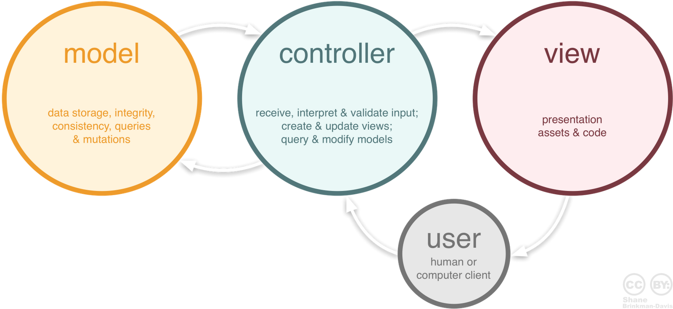
MVC Architecture
View
This level is majorly associated with the User Interface(UI) and it is used to provide the visual representation of the MVC model.
In simpler terms, this level deals with displaying the actual output to the user.
It also handles the communication between the user (inputs, requests, etc.) and the controller.
Image Source: https://www.codeproject.com/KB/java/879896/mvc_role_diagram.png
Notes:
This slide talks about the case if we have to divide a subtopic further.
Title Box - Parent Topic
Subtitle box - Sub Topic
Body Text - Subtopic divisions (Subtopics of subtopics)

Slide 9
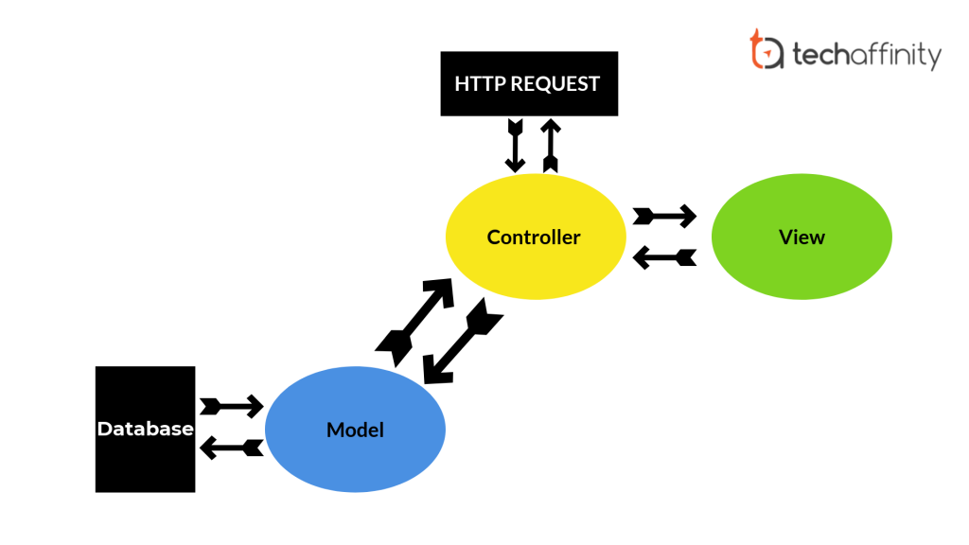
MVC Architecture
Controller
This level takes care of the request handler.
It is often considered as the brain of the MVC system- a link, so to speak, between the user and the system.
The controller completes the cycle of taking the user output, converting it into desired messages, and passing them on to the views(UI).
Image Source: https://techaffinity.com/blog/wp-content/uploads/2019/07/MVC-Architecture-TechAffinity-1024x576.png
Notes:
This slide talks about the case if we have to divide a subtopic further.
Title Box - Parent Topic
Subtitle box - Sub Topic
Body Text - Subtopic divisions (Subtopics of subtopics)

Slide 10
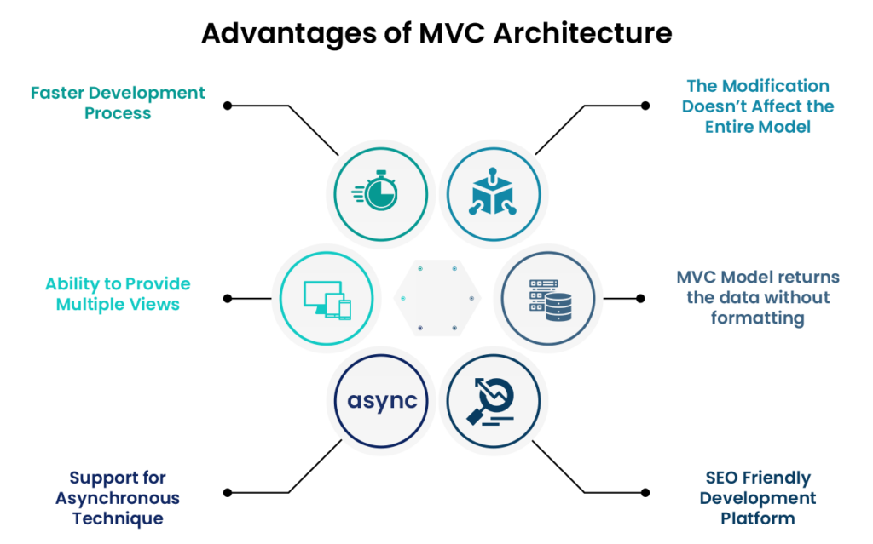
Introduction to MVC Architecture
Advantage of MVC
Organizes large-size web applications
Supports Asynchronous Method Invocation (AMI)
Easily Modifiable
Faster Development Process
Easy planning and maintenance
Returns data without formatting
Supports TTD (test-driven development)
Multiple Views
SEO-Friendly Platform
Image Source: https://shreysharma.com/wp-content/uploads/2021/05/Advantages-of-MVC-1024x639.png
Notes:
This slide talks about the case if we have to divide a subtopic further.
Title Box - Parent Topic
Subtitle box - Sub Topic
Body Text - Subtopic divisions (Subtopics of subtopics)

Slide 11
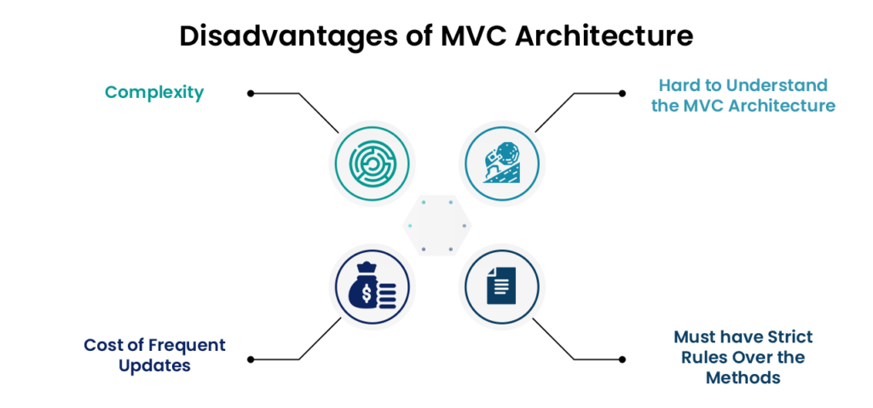
Introduction to MVC Architecture
Disadvantages of MVC
The complexity is high.
Not suitable for small applications.
The inefficiency of data access in view.
Image Source: https://shreysharma.com/wp-content/uploads/2021/05/Disadvantage-of-MVC-1024x479.png
Notes:
This slide talks about the case if we have to divide a subtopic further.
Title Box - Parent Topic
Subtitle box - Sub Topic
Body Text - Subtopic divisions (Subtopics of subtopics)

Slide 12
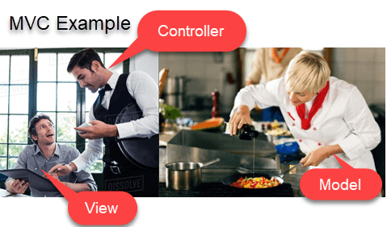
Introduction to MVC Architecture
MVC Example 1
Let’s see Model View Controller example from daily life. In this MVC architecture example,
View= You
Waiter= Controller
Cook= Model
Refrigerator= Data
Image source: https://www.guru99.com/images/1/122118_0445_MVCTutorial2.png
Notes:
This slide talks about the case if we have to divide a subtopic further.
Title Box - Parent Topic
Subtitle box - Sub Topic
Body Text - Subtopic divisions (Subtopics of subtopics)

Slide 13
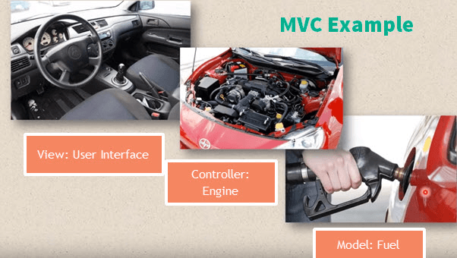
Introduction to MVC Architecture
MVC Example 2
Car driving mechanism is another example of the MVC model.Every car consists of three main parts.
View= User interface : (Gear lever, panels, steering wheel, brake, etc.)
Controller- Mechanism (Engine)
Model- Storage (Petrol or Diesel tank)
Image Source: https://www.guru99.com/images/1/122118_0445_MVCTutorial3.png
Notes:
This slide talks about the case if we have to divide a subtopic further.
Title Box - Parent Topic
Subtitle box - Sub Topic
Body Text - Subtopic divisions (Subtopics of subtopics)

Slide 14
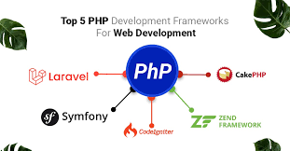
Introduction to MVC Architecture
Popular MVC web frameworks
Django
Laravel
CodeIgniter
Symphony
CakePHP
CherryPy
Spring MVC
Ruby
Image Source: https://encrypted-tbn0.gstatic.com/images?q=tbn:ANd9GcSn90IPA7GwIM2vnme_AImycQswV1OPiIq2GJ-Nm6bx3aMRKjwFak_wmpIGIiRtTYRBXYU&usqp=CAU
Notes:
This slide talks about the case if we have to divide a subtopic further.
Title Box - Parent Topic
Subtitle box - Sub Topic
Body Text - Subtopic divisions (Subtopics of subtopics)

Slide 15
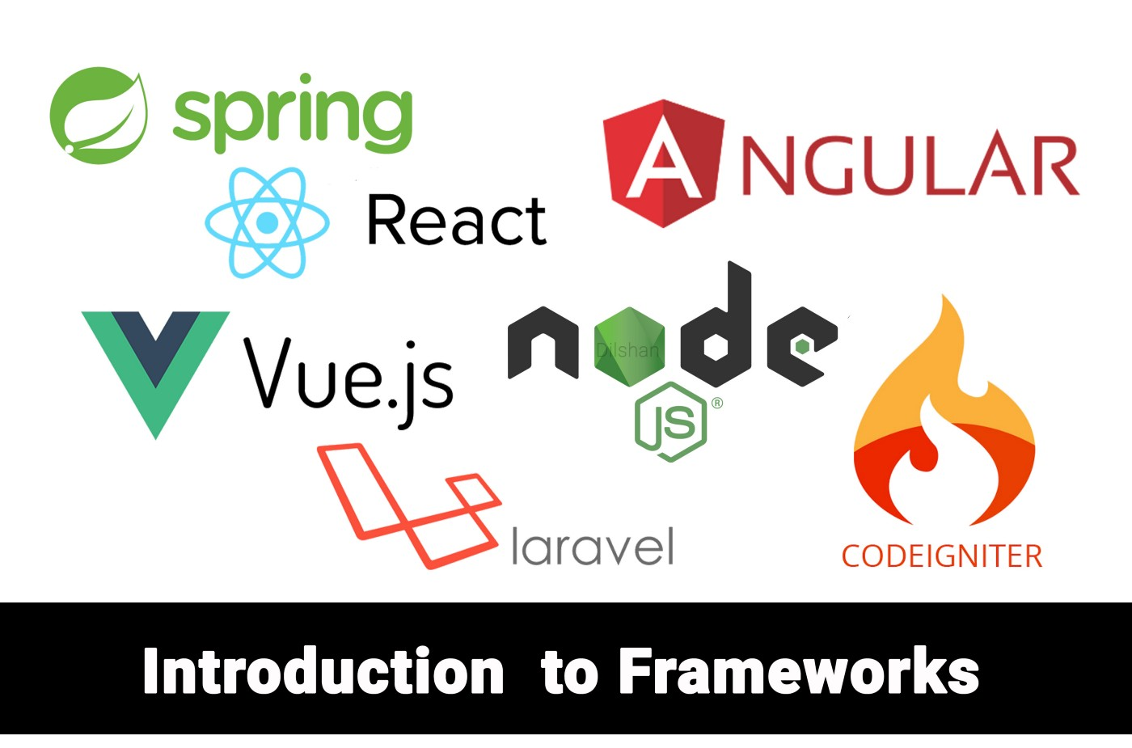
What is Framework and its Benefits
Introduction to a Framework
Since they are often built, tested, and optimized by several experienced software engineers and programmers, software frameworks are versatile, robust, and efficient.
Using a software framework to develop applications lets you focus on the high-level functionality of the application.
Image Source: https://miro.medium.com/max/1400/1*sTxxPZje3wLTOICryb6bSA.jpeg
Notes:
This slide talks about the case if we have to divide a subtopic further.
Title Box - Parent Topic
Subtitle box - Sub Topic
Body Text - Subtopic divisions (Subtopics of subtopics)

Slide 16
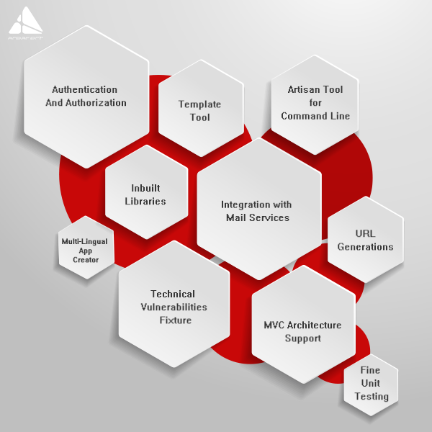
What is Framework and its Benefits
Why do we use Frameworks?
Assists in establishing better programming practices and fitting use of design patterns
Code is more secure
Duplicate and redundant code can be avoided
Helps consistent developing code with fewer bugs
Makes it easier to work on sophisticated technologies
Image Source: https://www.arpatech.com/blog/wp-content/uploads/2019/04/laravel-all-benefits.png
Notes:
This slide talks about the case if we have to divide a subtopic further.
Title Box - Parent Topic
Subtitle box - Sub Topic
Body Text - Subtopic divisions (Subtopics of subtopics)

Slide 17
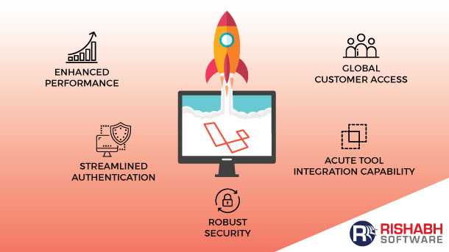
What is Framework and its Benefits
What goes in a Framework?
When you install a software framework, the first thing that you need to take care of is the system requirements.
Once a framework is installed and configured, it creates a directory structure.
Image Source: https://www.rishabhsoft.com/wp-content/uploads/2018/09/why-businesses-choose-laravel-php-framework.jpg
Notes:
This slide talks about the case if we have to divide a subtopic further.
Title Box - Parent Topic
Subtitle box - Sub Topic
Body Text - Subtopic divisions (Subtopics of subtopics)

Slide 18
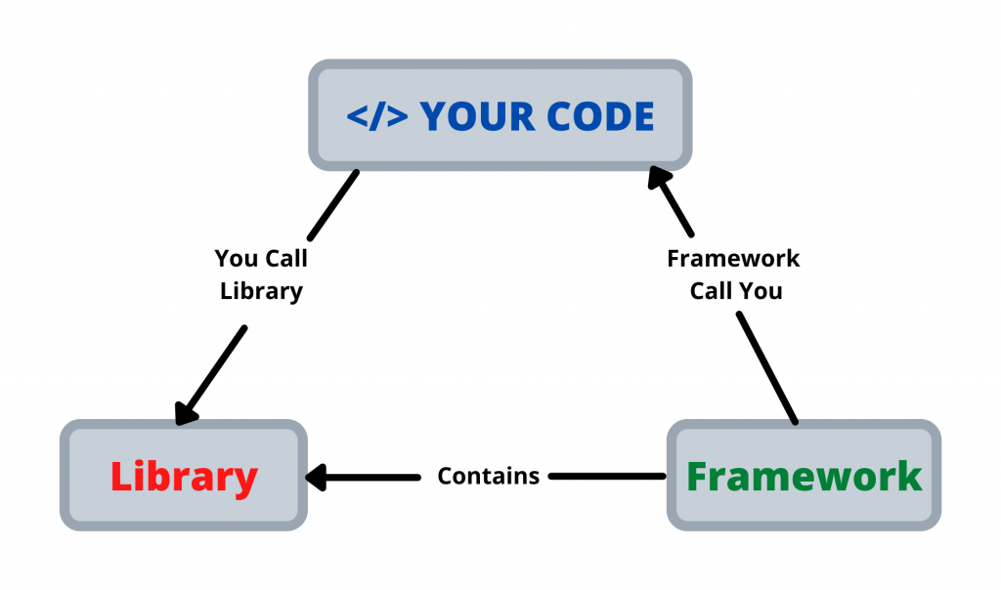
What is Framework and its Benefits
Difference between a Library and a Framework
Some may assume that a software framework is a collection of libraries just as libraries are a collection of precompiled routines.
However, this is not true as not all software frameworks use or depend on libraries.
The difference between a library and a framework is that the latter calls the code. Opposite to this, the code calls the software library.
Image Source: https://kobaltsolutions.com/wp-content/uploads/2021/02/YOUR-CODE-1024x604.png
Notes:
This slide talks about the case if we have to divide a subtopic further.
Title Box - Parent Topic
Subtitle box - Sub Topic
Body Text - Subtopic divisions (Subtopics of subtopics)

Slide 19
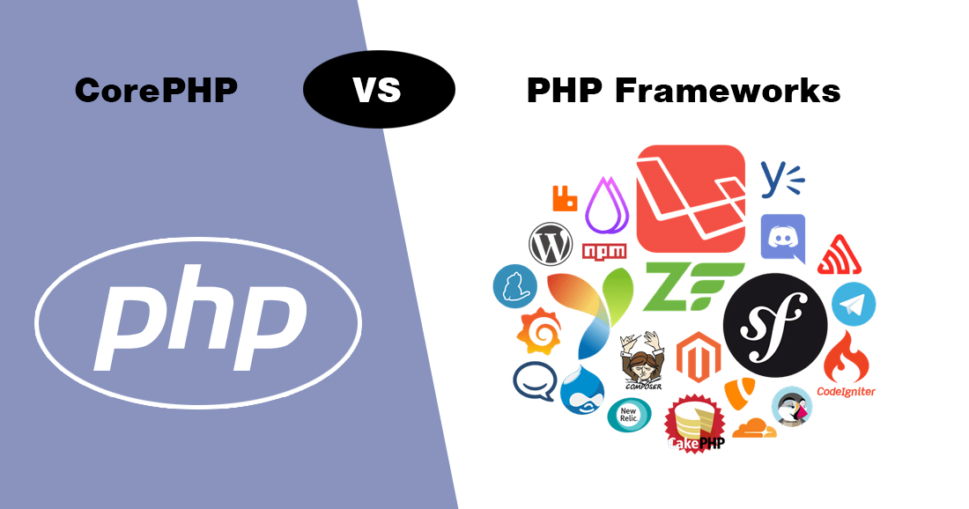
What is Framework and its Benefits
Programming language vs Frameworks
A programming language tells the computer what it should do.
Every programming language features a syntax and a particular set of rules, which need to be followed every time the code is written.
Image Source: https://cdn.nmgtechnologies.com/blog/wp-content/uploads/2017/11/blogBanner-PHP.jpg
Notes:
This slide talks about the case if we have to divide a subtopic further.
Title Box - Parent Topic
Subtitle box - Sub Topic
Body Text - Subtopic divisions (Subtopics of subtopics)

Slide 20
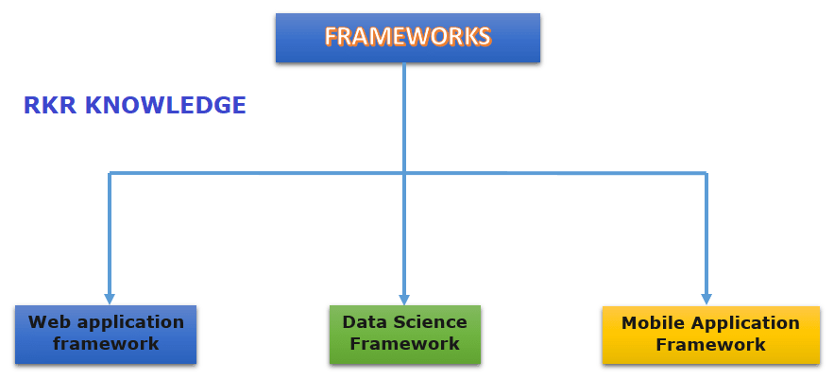
What is Framework and its Benefits
Types of Framework
Web Application Frameworks
DataScience Frameworks
Mobile Development Frameworks
Image Source: https://rkrknowledge.com/wp-content/uploads/2020/09/Screenshot-11.png
Notes:
This slide talks about the case if we have to divide a subtopic further.
Title Box - Parent Topic
Subtitle box - Sub Topic
Body Text - Subtopic divisions (Subtopics of subtopics)

Slide 21
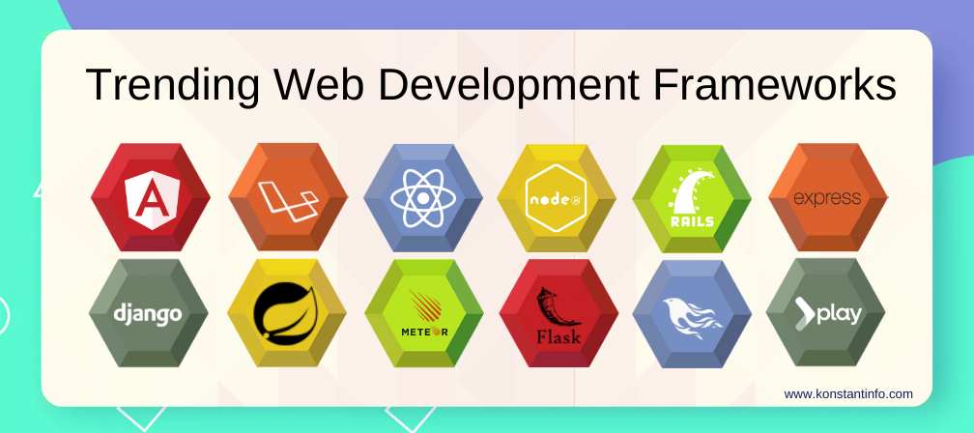
Types of Framework
Web Application Frameworks
Angular: Angular is a typescript-based, open-source JS framework that makes it easy to build applications on the web.
Laravel: Laravel is a PHP-based web application framework with an expressive, elegant syntax.
Image Source: https://www.konstantinfo.com/blog/wp-content/themes/konstantinfo/imageC.php?image=/2018/07/web-development-frameworks-2020.png
Notes:
This slide talks about the case if we have to divide a subtopic further.
Title Box - Parent Topic
Subtitle box - Sub Topic
Body Text - Subtopic divisions (Subtopics of subtopics)

Slide 22
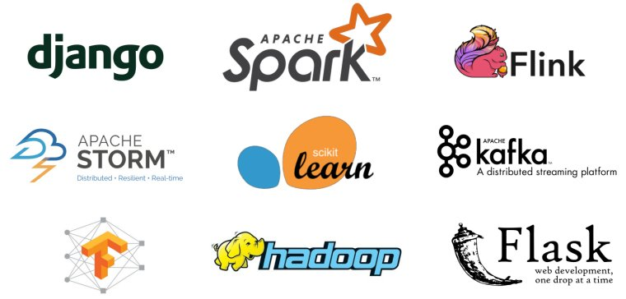
Types of Framework
DataScience Frameworks
Apache Spark
PyTorch
TensorFlow
Image Source: https://wonderfulengineering.com/wp-content/uploads/2018/09/Data-science-frameworks-1.jpg
Notes:
This slide talks about the case if we have to divide a subtopic further.
Title Box - Parent Topic
Subtitle box - Sub Topic
Body Text - Subtopic divisions (Subtopics of subtopics)

Slide 23
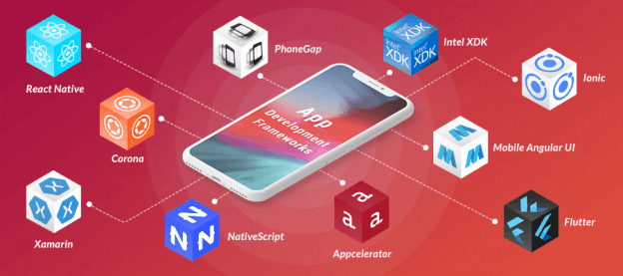
Types of Framework
Mobile Development Frameworks
Ionic
Xamarin
Flutter
Image Source: https://www.spaceotechnologies.com/wp-content/uploads/2021/03/frameworks2-624x277-1.png
Notes:
This slide talks about the case if we have to divide a subtopic further.
Title Box - Parent Topic
Subtitle box - Sub Topic
Body Text - Subtopic divisions (Subtopics of subtopics)

Slide 24
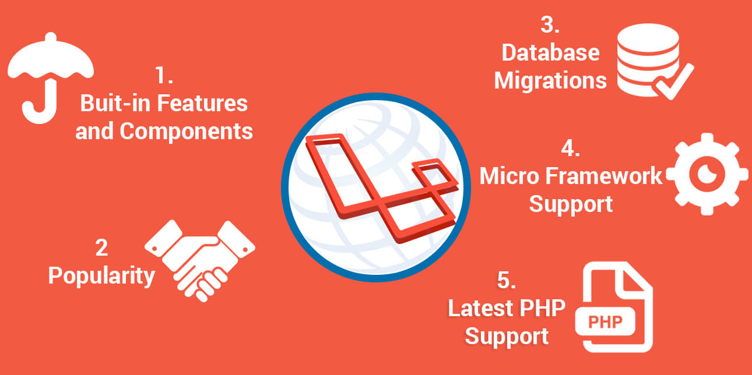
Laravel and its Architecture
What is Laravel
Laravel is a web application framework with expressive, elegant syntax.
A web framework provides a structure and starting point for creating your application, allowing you to focus on creating something amazing while we sweat the details.
The Laravel Framework was developed by Taylor Otwell and released to the public in the year 2011.
Image Source: https://www.mindinventory.com/blog/wp-content/uploads/2016/10/laravel.jpg
Notes:
This slide talks about the case if we have to divide a subtopic further.
Title Box - Parent Topic
Subtitle box - Sub Topic
Body Text - Subtopic divisions (Subtopics of subtopics)

Slide 25
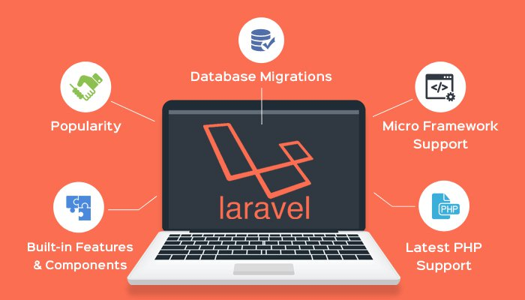
Laravel and its Architecture
Why Laravel
There are a variety of tools and frameworks available to you when building a web application.
However, we believe Laravel is the best choice for building modern, full-stack web applications.
Image Source: https://res.cloudinary.com/jerrick/image/upload/v1623836011/60c9c56b8d2527001f049f1d.jpg
Notes:
This slide talks about the case if we have to divide a subtopic further.
Title Box - Parent Topic
Subtitle box - Sub Topic
Body Text - Subtopic divisions (Subtopics of subtopics)

Slide 26
Laravel and its Architecture
Why Laravel
A Progressive Framework
A Scalable Framework
MVC Architecture of Laravel
Image Source: https://res.cloudinary.com/jerrick/image/upload/v1623836011/60c9c56b8d2527001f049f1d.jpg
Notes:
This slide talks about the case if we have to divide a subtopic further.
Title Box - Parent Topic
Subtitle box - Sub Topic
Body Text - Subtopic divisions (Subtopics of subtopics)

Slide 27
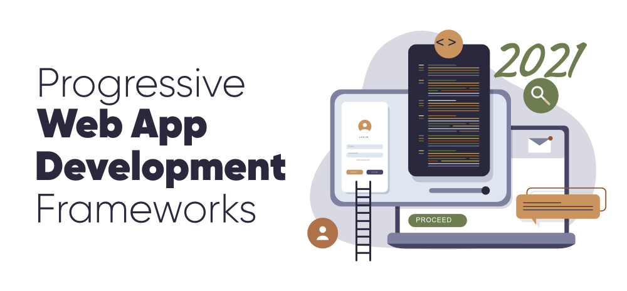
Why Laravel
A Progressive Framework
We like to call Laravel a "progressive" framework.
By that, we mean that Laravel grows with you.
Laravel gives us robust tools for dependency injection, unit testing, queues, real-time events, and more.
Image Source: https://media.geeksforgeeks.org/wp-content/cdn-uploads/20201218211223/7-Progressive-Web-App-Development-Frameworks-to-Know-in-2021.png
Notes:
This slide talks about the case if we have to divide a subtopic further.
Title Box - Parent Topic
Subtitle box - Sub Topic
Body Text - Subtopic divisions (Subtopics of subtopics)

Slide 28
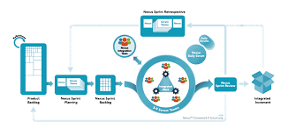
Why Laravel
A Scalable Framework
Laravel is incredibly scalable.
Laravel applications have been easily scaled to handle hundreds of millions of requests per month.
Image Source:https://www.google.com/url?sa=i&url=https%3A%2F%2Fluis-goncalves.com%2Fwhy-safe-is-better-than-any-other-scalable-agile-framework%2F&psig=AOvVaw0x2q4ypfkuAMwuy-90Cawv&ust=1647067133006000&source=images&cd=vfe&ved=0CAsQjRxqFwoTCJj5t8K5vfYCFQAAAAAdAAAAABAD
Notes:
This slide talks about the case if we have to divide a subtopic further.
Title Box - Parent Topic
Subtitle box - Sub Topic
Body Text - Subtopic divisions (Subtopics of subtopics)

Slide 29
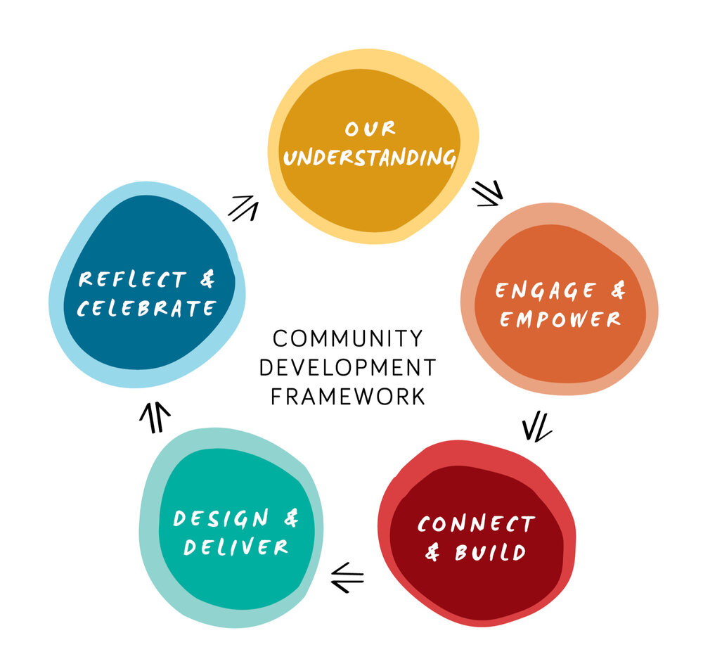
Why Laravel
A Community Framework
Laravel combines the best packages in the PHP ecosystem to offer the most robust and developer friendly framework available.
In addition, thousands of talented developers from around the world have contributed to the framework.
Image Source: https://images.squarespace-cdn.com/content/v1/5df6bf8c5a9fd4488885978d/1584659880828-RGUPD3N7KCCD4X601DWM/Community%2BDevelopment%2BFramework%2Bdiagram.jpg?format=1000w
Notes:
This slide talks about the case if we have to divide a subtopic further.
Title Box - Parent Topic
Subtitle box - Sub Topic
Body Text - Subtopic divisions (Subtopics of subtopics)

Slide 30
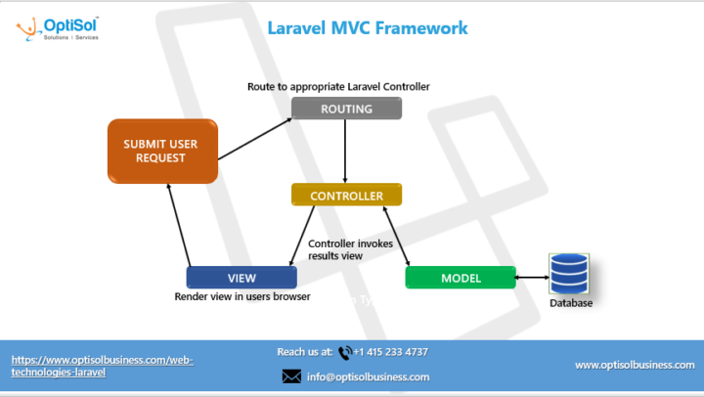
Laravel and its Architecture
MVC Architecture of Laravel
The Laravel Framework follows MVC architecture.
MVC is an architectural design pattern that helps to develop web applications faster.
Image Source:https://www.optisolbusiness.com/wp-content/uploads/2020/02/Laravel_MVC_Infographic_OptiSol-thegem-blog-timeline-large.png
Notes:
Continuing from the last slide:
Title - Subtopic
Subtitle - Subtopic of Subtopic
Body - Description

Slide 31
Laravel and its Architecture
MVC Architecture of Laravel
MVC stands for Model-View-Controller.
Model (M)
View (V)
Controller (C)
Image Source:https://www.optisolbusiness.com/wp-content/uploads/2020/02/Laravel_MVC_Infographic_OptiSol-thegem-blog-timeline-large.png
Notes:
Continuing from the last slide:
Title - Subtopic
Subtitle - Subtopic of Subtopic
Body - Description

Slide 32
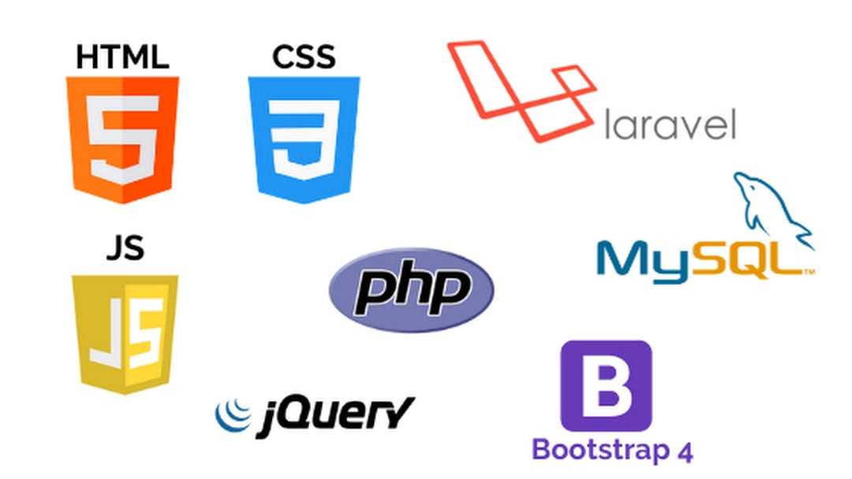
Laravel and its Architecture
Pre-requisites For Laravel
Before proceeding further with this tutorial, you need to be familiar with the following concepts.
HTML and CSS
Core PHP and Advanced PHP
Web application development using PHP and MySQL
MVC architecture
Image Source: https://fiverr-res.cloudinary.com/images/q_auto,f_auto/gigs/169894929/original/94910352a0d02f831fe7f283397e57634dd9b45a/be-your-web-developer-for-php-laravel-websites.png
Notes:
Continuing from the last slide:
Title - Subtopic
Subtitle - Subtopic of Subtopic
Body - Description

Slide 33
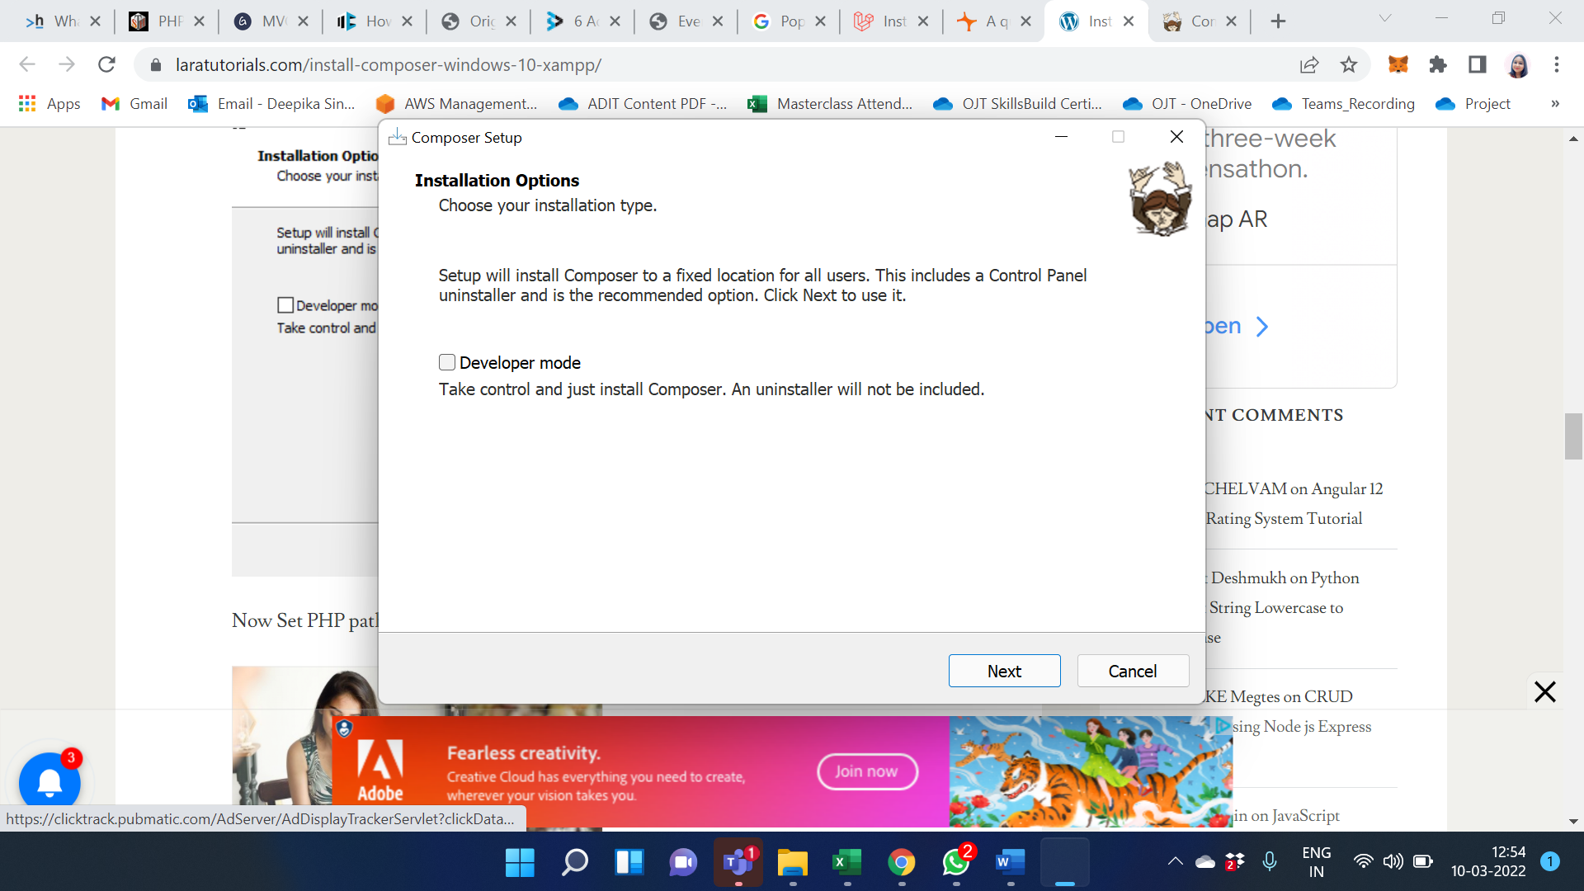
Laravel and its Architecture
Install Laravel framework 8 for windows 10
Install composer on Windows. Follow below given steps to install composer on windows 10:
Step 1: Download Composer .exe File
Click Download Composer from www.getcomposer.org.
Step 2 – Run the setup and Install Composer
Notes:
Continuing from the last slide:
Title - Subtopic
Subtitle - Subtopic of Subtopic
Body - Description

Slide 34
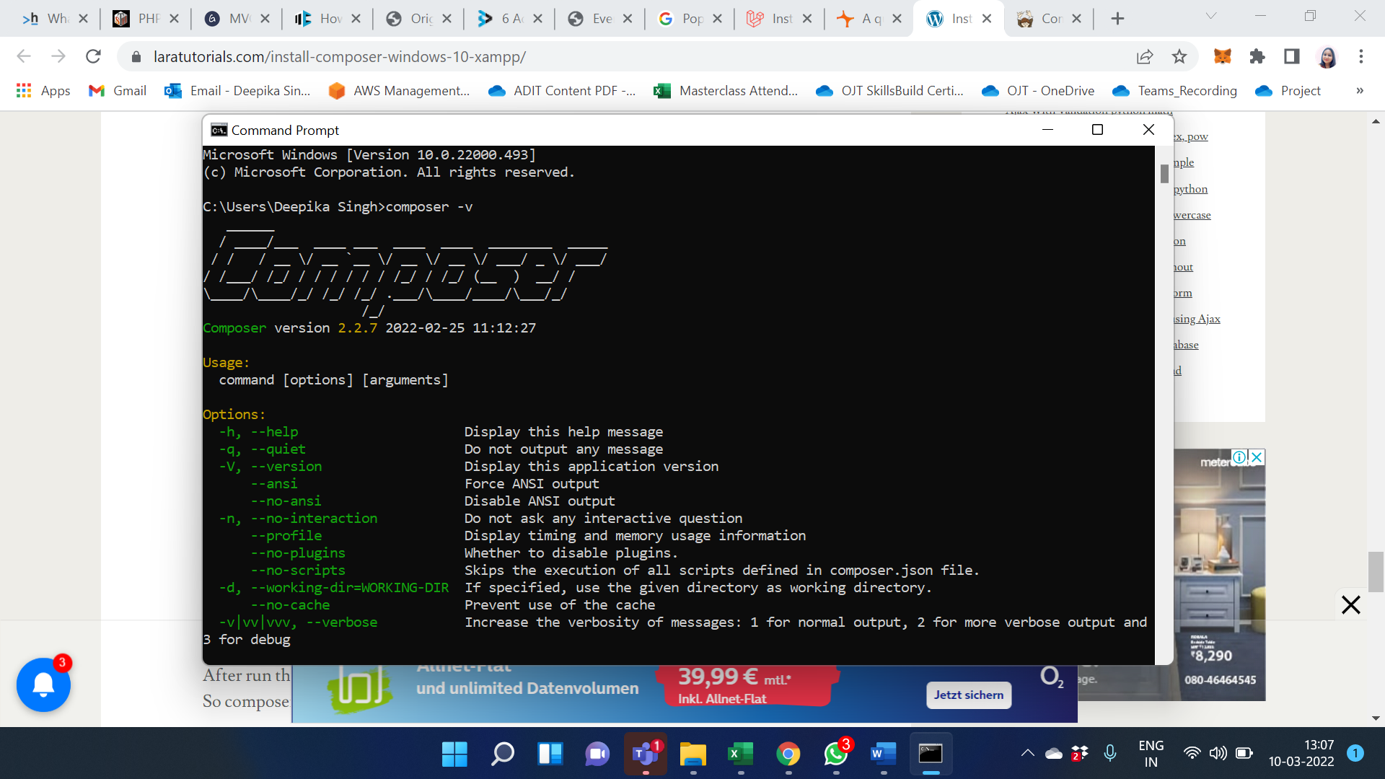
Laravel and its Architecture
Install Laravel framework 8 for windows 10
Step 3 – How to check composer is installed or not in windows
Now, open your terminal and type the following command on command prompt and check whether composer successfully installed on your windows 10 xampp or not.
Notes:
Continuing from the last slide:
Title - Subtopic
Subtitle - Subtopic of Subtopic
Body - Description

Slide 35
Laravel and its Architecture
Check the server requirement for the setup
PHP >= 7.3
BCMath PHP Extension
Ctype PHP Extension
Fileinfo PHP extension
JSON PHP Extension
Mbstring PHP Extension
OpenSSL PHP Extension
PDO PHP Extension
Tokenizer PHP Extension
XML PHP Extension.
Notes:
Continuing from the last slide:
Title - Subtopic
Subtitle - Subtopic of Subtopic
Body - Description

Slide 36
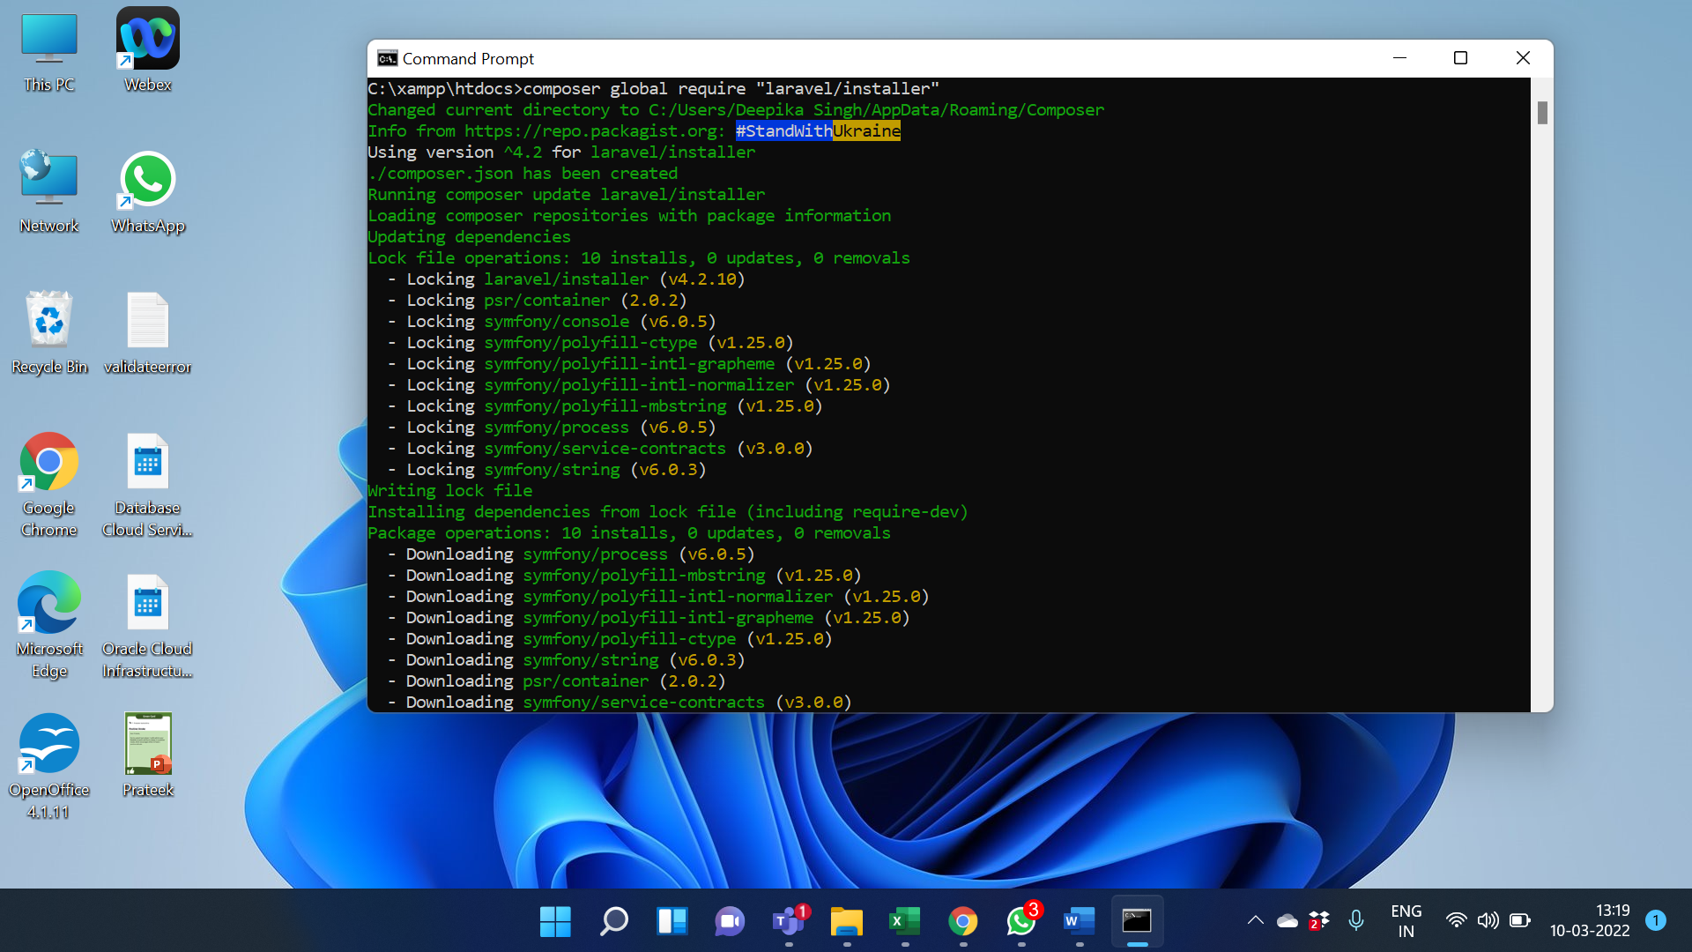
Laravel and its Architecture
Installing Laravel
Type the following command in your command prompt window:
composer global require “laravel/installer”.
composer create-project –prefer-dist laravel/laravel Project_name: this command will install Laravel and other dependencies with it also generate the ANSI key.
Notes:
Continuing from the last slide:
Title - Subtopic
Subtitle - Subtopic of Subtopic
Body - Description

Slide 37
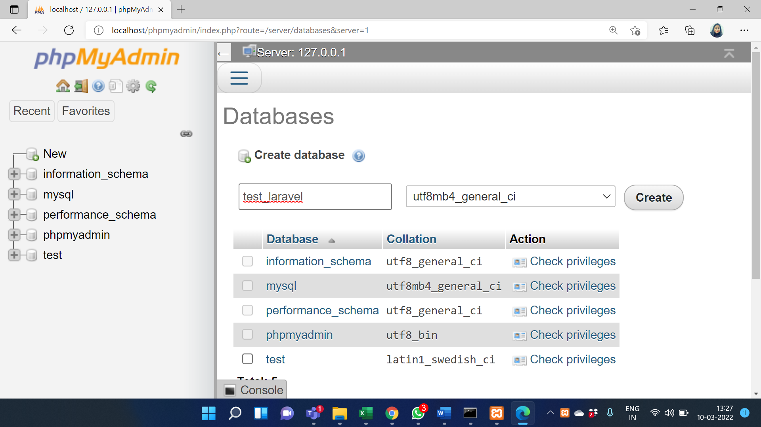
Laravel and its Architecture
Create Database for Project
Go to phpMyAdmin click on create a new tab.
Name the database.
Press create button.
Notes:
Continuing from the last slide:
Title - Subtopic
Subtitle - Subtopic of Subtopic
Body - Description

Slide 38
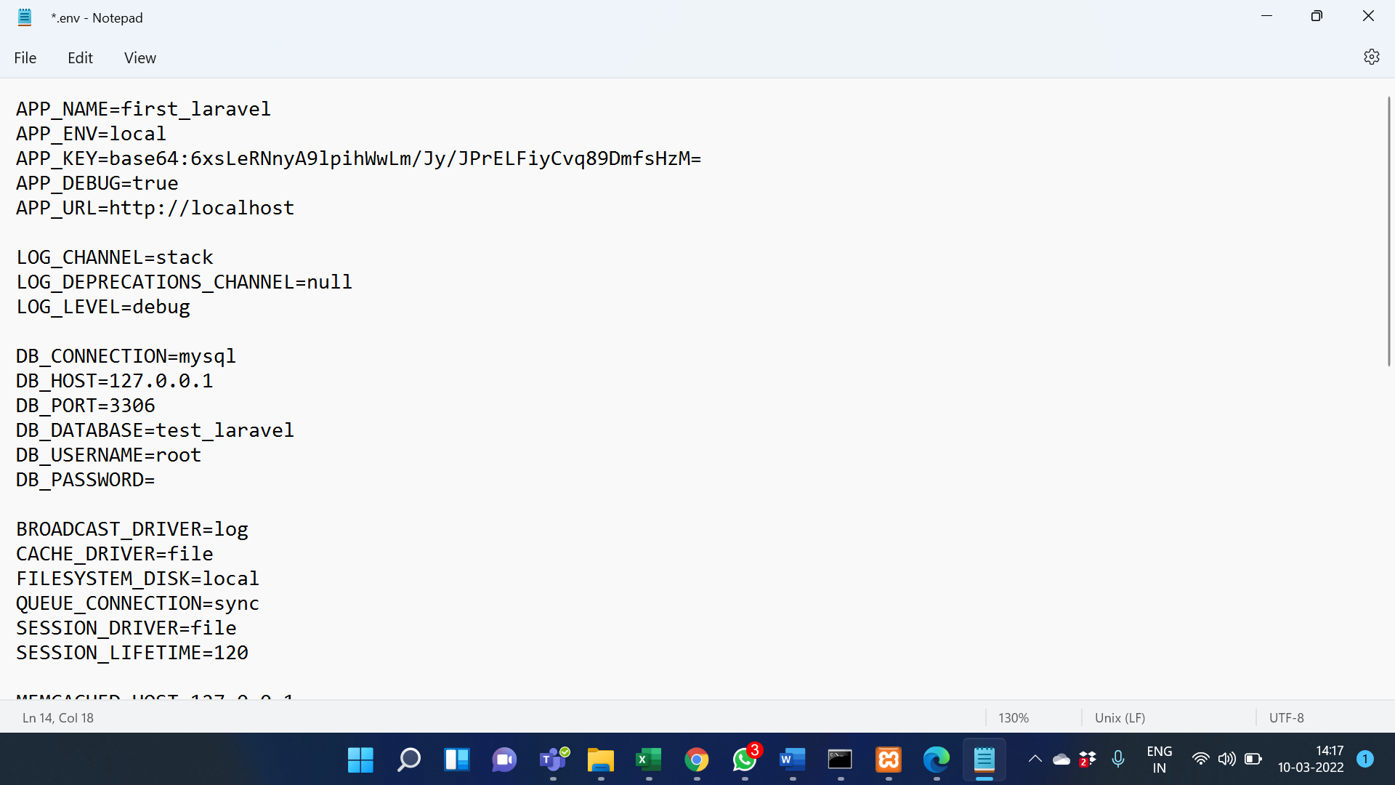
Laravel and its Architecture
Create Database for Project
Update .env file
Notes:
Continuing from the last slide:
Title - Subtopic
Subtitle - Subtopic of Subtopic
Body - Description

Slide 39
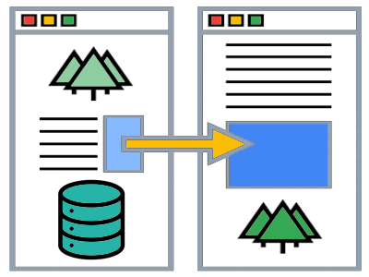
Laravel and its Architecture
Migrate Database
PHP artisan make migration create_databse_table: this command is used to create the DB migration file in your ‘database/migration’ folder.
PHP artisan migrate: used to run the pending migration changes to the database
Image Source: https://vegibit.com/wp-content/uploads/2015/03/generate-migrations-from-existing-database.png
Notes:
Continuing from the last slide:
Title - Subtopic
Subtitle - Subtopic of Subtopic
Body - Description

Slide 40
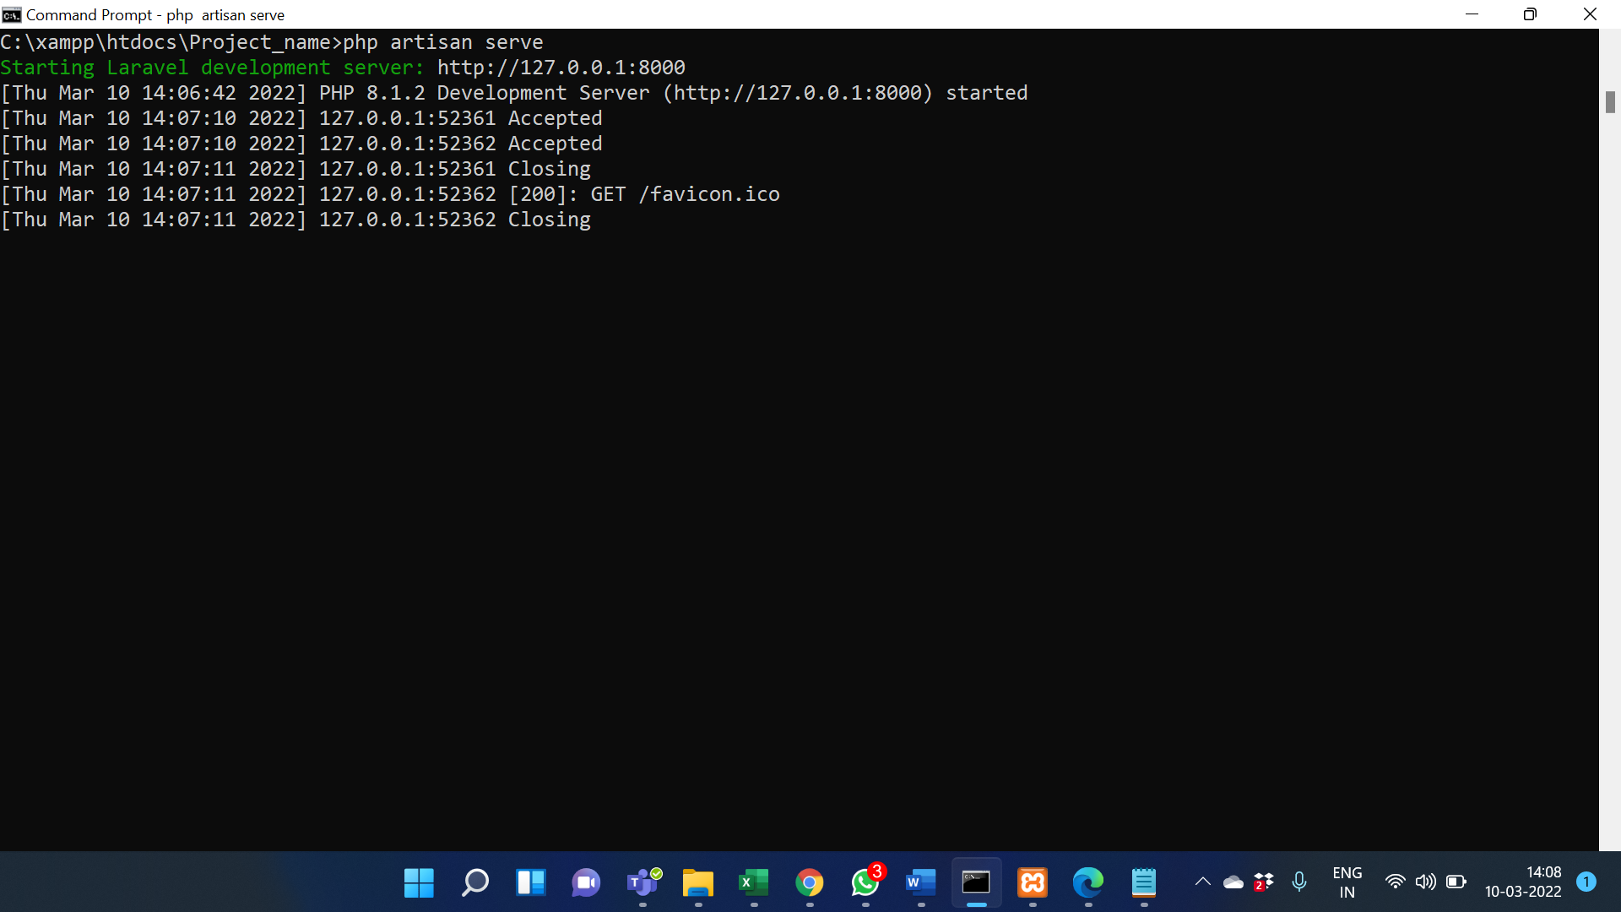
Laravel and its Architecture
Start development server
PHP artisan serve: this command starts your development server.
Notes:
Continuing from the last slide:
Title - Subtopic
Subtitle - Subtopic of Subtopic
Body - Description

Slide 41
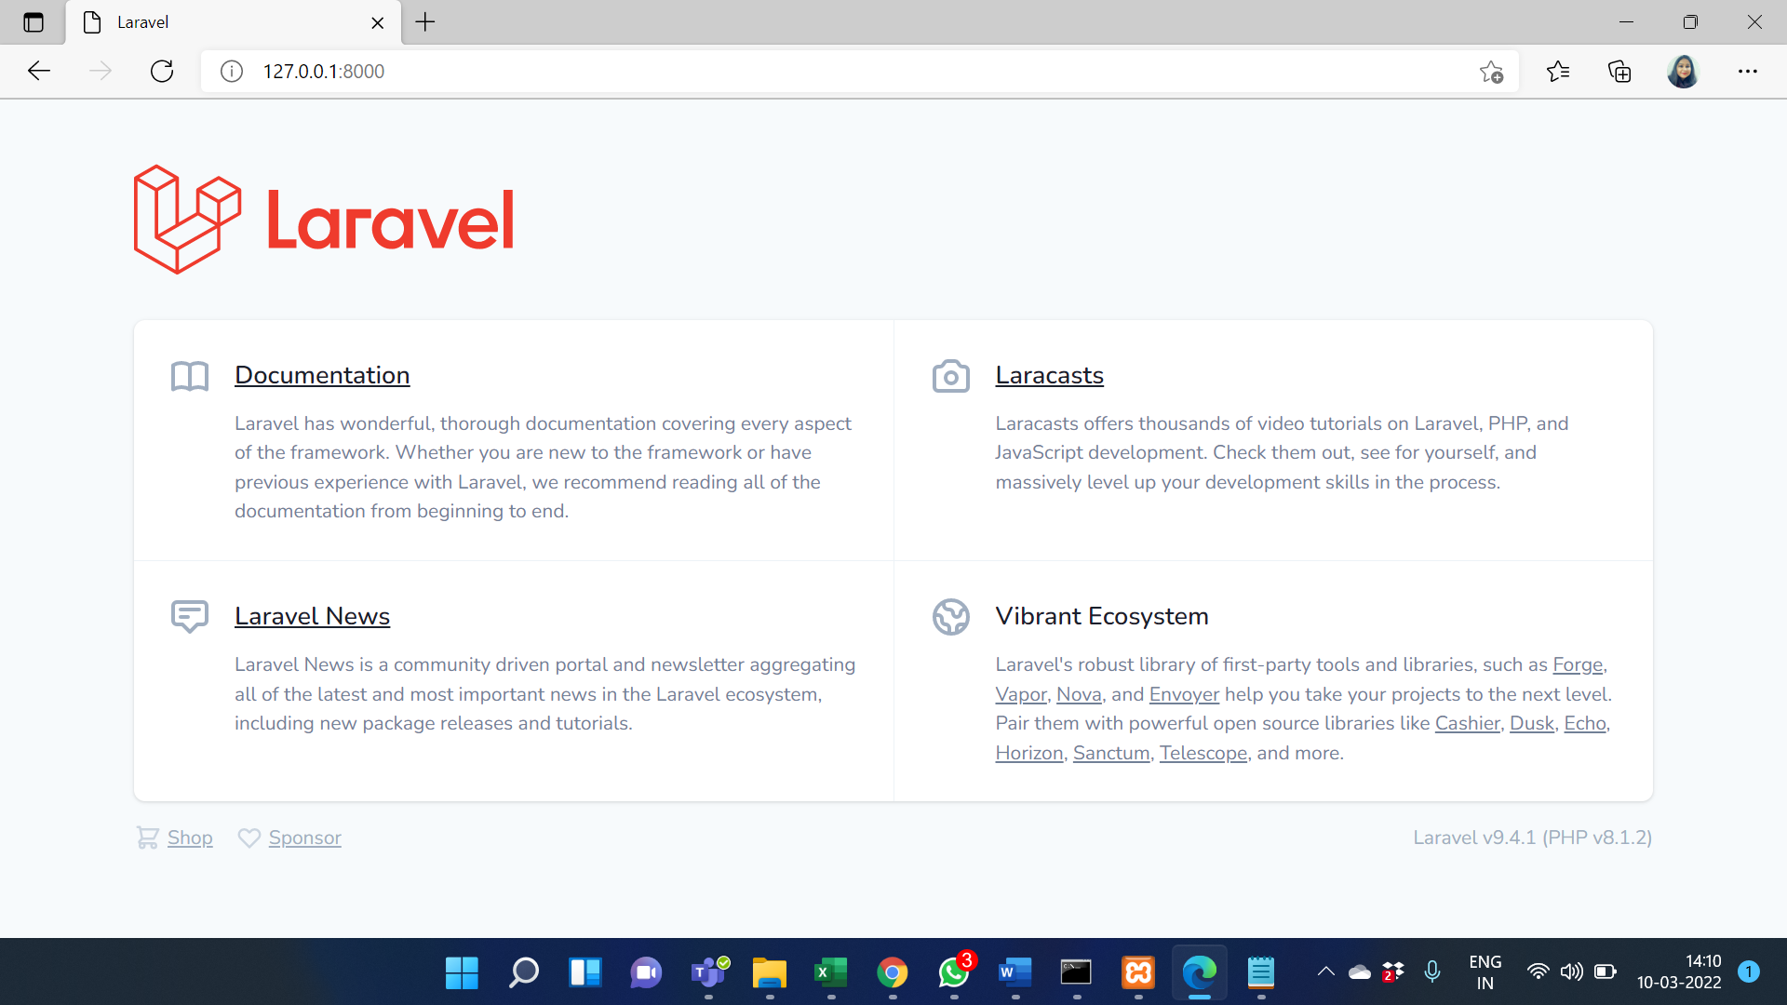
Laravel and its Architecture
Start development server
Go to the IP URL that you see on your CMD screen.
Notes:
Continuing from the last slide:
Title - Subtopic
Subtitle - Subtopic of Subtopic
Body - Description

Slide 42
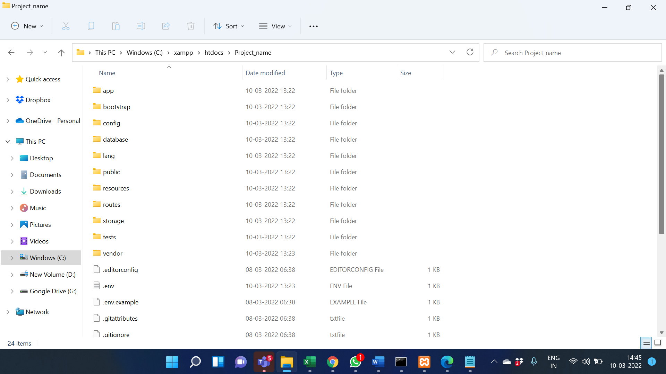
Laravel and its Architecture
Laravel PHP Project Structure
The project structure consists of directories, sub-directories, and files.
Open your project from the File Explorer to see the root directory structure of the Laravel project. You will see a screen similar to this.
Image Source:
Notes:
Continuing from the last slide:
Title - Subtopic
Subtitle - Subtopic of Subtopic
Body - Description

Slide 43
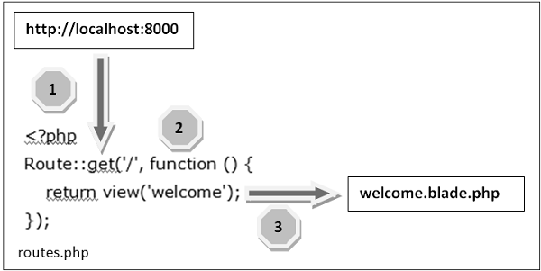
Laravel and its Architecture
Introduction To Laravel Routes
Routing accepts the request and redirects it to the relevant controller function.
There are two main route files in the Laravel Framework:
routes/web.php: This file is used to register web routes.
routes/api.php: This file is used to register API routes.
Image Source: https://www.tutorialspoint.com/laravel/images/routing_mechanism.jpg
Notes:
Continuing from the last slide:
Title - Subtopic
Subtitle - Subtopic of Subtopic
Body - Description

Slide 44
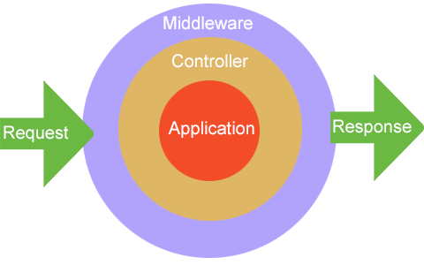
Laravel and its Architecture
What Is Middleware
In simple words, middleware is a bridge between a request and a response.
It provides a mechanism to filter HTTP requests.
All the middleware files are stored in the app/Http/Middleware directory.
Image Source: https://w3programmers.com/bangla/wp-content/uploads/2017/12/Middleware2.png
Notes:
Continuing from the last slide:
Title - Subtopic
Subtitle - Subtopic of Subtopic
Body - Description

Slide 45
Laravel and its Architecture
Introduction To Terminable Middleware
Run the following command in the command prompt to create a terminable middleware named TerminateMiddleware.
php artisan make:middleware TerminateMiddleware
This command will create a file named TerminateMiddleware.php in the app/Http/Middleware directory.
Image Source:
Image Source: https://w3programmers.com/bangla/wp-content/uploads/2017/12/Middleware2.png
Notes:
Continuing from the last slide:
Title - Subtopic
Subtitle - Subtopic of Subtopic
Body - Description

Slide 46
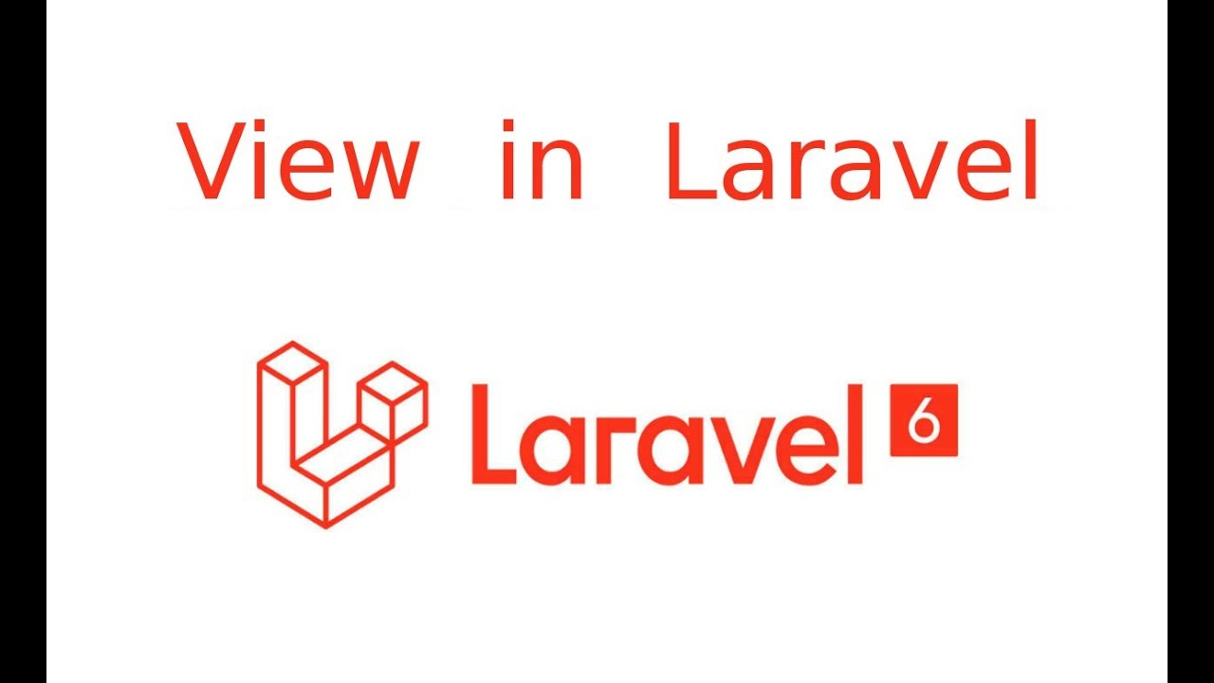
Laravel and its Architecture
Introduction To Views
In MVC architecture, the character ‘V’ stands for View.
Views contain HTML, CSS and JavaScript.
The Views represent the frontend of the Laravel application, and it is used to display the content for the user.
All the views are stored in the resources/views directory. By default, the Laravel Framework provides the welcome.blade.php file.
Image Source: https://i.ytimg.com/vi/MwTs_ujIVuo/maxresdefault.jpg
Notes:
Continuing from the last slide:
Title - Subtopic
Subtitle - Subtopic of Subtopic
Body - Description

Slide 47
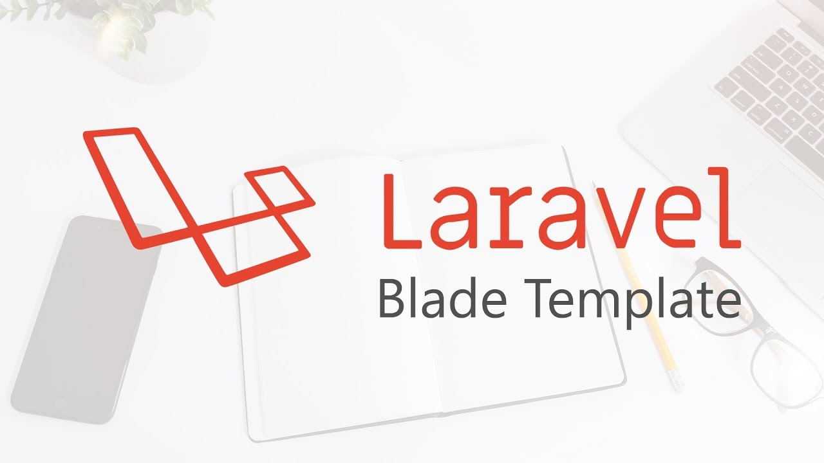
Blade templating engine in laravel
Introduction to Blade Template
Blade templates use .blade.php extension. The blade templates stored in the resources/views directory.
Image Source: https://kodlamaklazim.com/images/blog_content_image/TVgfmfQATDi5vKwpPHBjblade.jpg
Notes:
Continuing from the last slide:
Title - Subtopic
Subtitle - Subtopic of Subtopic
Body - Description

Slide 48
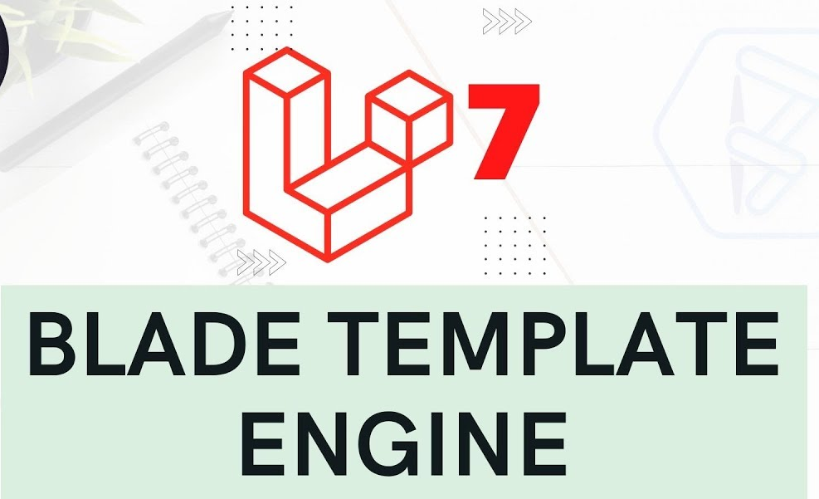
Blade templating engine in laravel
Usage of Blade Templates
Usage 1: variable values
Usage 2: ternary operators
Image Source: https://i.ytimg.com/vi/Kw7ytwxo6uE/maxresdefault.jpg
Notes:
Continuing from the last slide:
Title - Subtopic
Subtitle - Subtopic of Subtopic
Body - Description

Slide 49
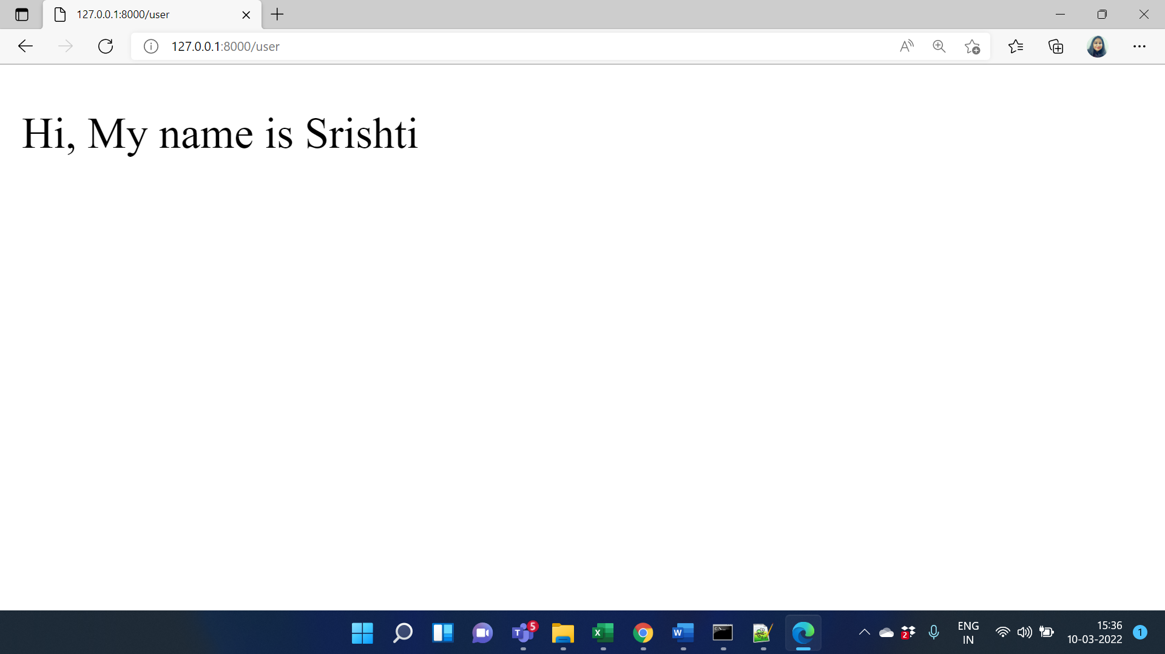
Blade templating engine in laravel
Usage of Blade Templates
Usage 1: variable values
In blade templates, we can use {{ $variable }} to print the value of a variable instead of <?php echo $variable ?> As you see, there is no need to write PHP tags or the echo keyword.
Notes:
Continuing from the last slide:
Title - Subtopic
Subtitle - Subtopic of Subtopic
Body - Description

Slide 50
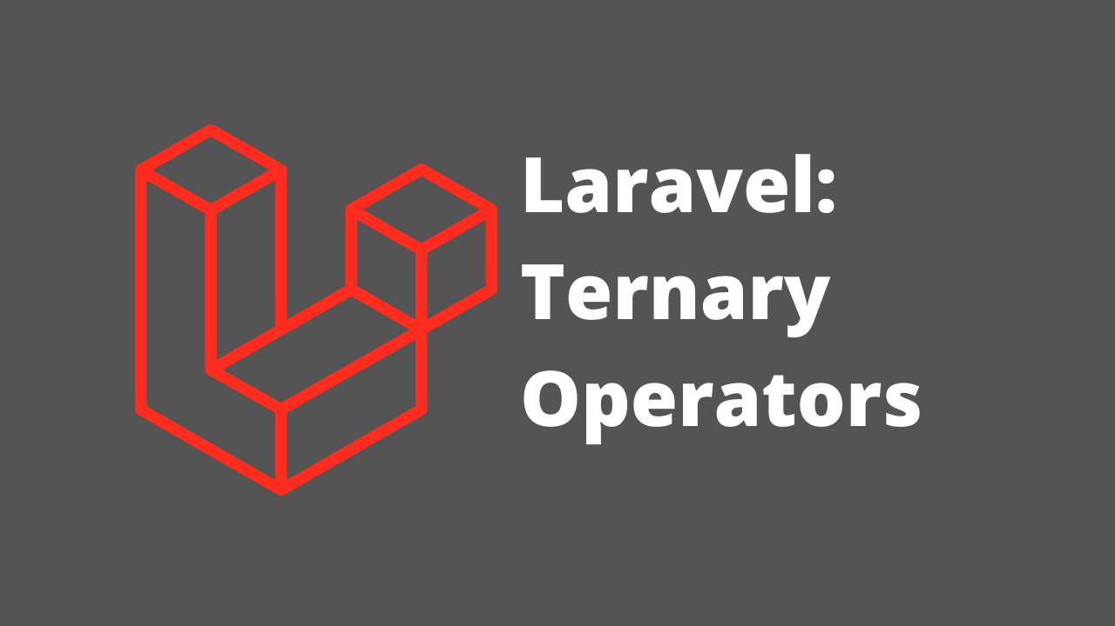
Blade templating engine in laravel
Usage of Blade Templates
Usage 2: ternary operators
In blade templates, we can use {{ $variable or ‘default_value’ }} instead of <?phpisset($variable) ? $variable : ?default_value? ?> to write ternary operators.
Image Source: https://i0.wp.com/thecodecheatsheet.com/wp-content/uploads/2021/03/Laravel-ternary-operator.png?fit=1280%2C720&ssl=1
Notes:
Continuing from the last slide:
Title - Subtopic
Subtitle - Subtopic of Subtopic
Body - Description

